Slide 1
Telescope Parallel Actuator Mount: Control and Testing
Sam Artho-Bentz
Notes:
Focus primarily on Mechatronics
Follow up to Garrett Gudgel’s thesis
DO NOT say “try”
“I did…”
No uhh’s, no “stuff” and “things”
Add graphics references

Slide 2
Goals
Design
Control
Testing
Design improvements
Notes:
Don’t read slide: expand on this

Slide 3
Goals
Further investigate the viability of the Parallel Actuator Mount for astronomical use
Minimize custom built components, especially in the control system
Develop velocity control
Develop software that can be customized and expanded by others implementing this style of mount.
Establish testing protocol to allow future iterations of the PAM to be compared.

Slide 4
Background

Slide 5
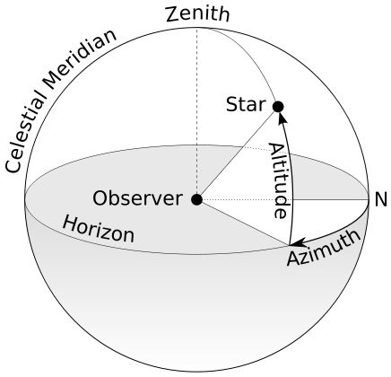
Pointing a Telescope
Multiple ways to define where a telescope is pointing
Altitude-Azimuth vs Right Ascension-Declination
Notes:
Altitude Azimuth is a local coordinate system
describes where a telescope is pointing.
Altitude is angle above the horizon
Azimuth is angle about an axis perpendicular to Earth’s surface, starting from some reference point (generally north or south)
Right Ascension Declination is used to give celestial coordinate
based on a specific date and location.

Slide 6
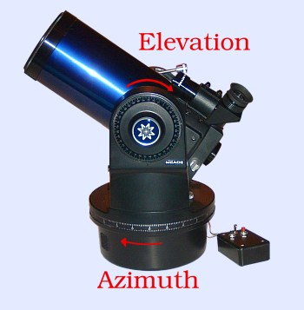
Image Rotation Angle
Angle of the Optical Tube Assembly (OTA) relative to the object viewed
Required for long exposure photography
Notes:
Hold tube to demonstrate this

Slide 7
Altitude-Azimuth Mount
Pros:
Direct encoder measurement of axes of interest
Cons:
Requires ‘image derotation’ for long exposure photography
Series mounted actuators require stronger motors

Slide 8
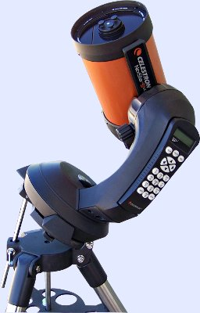
Equatorial Mount
Pros:
Does not require image derotation
Direct encoder measurement of axes
Cons:
Complicated load paths require heavier mount
Series mounted actuators require stronger motors
Notes:
Tilt to align with Earth’s rotational axis

Slide 9
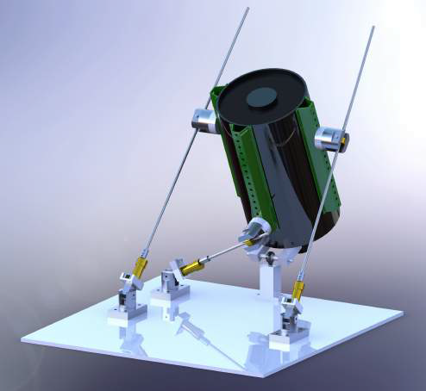
Parallel Actuator Mount
Pros:
Parallel Actuators share load
Two force members lead to simplified loading
Cons:
No direct measurement of desired angles
Notes:
Conceived by Dr. John Ridgely and initially implemented by Garrett Gudgel.

Slide 10
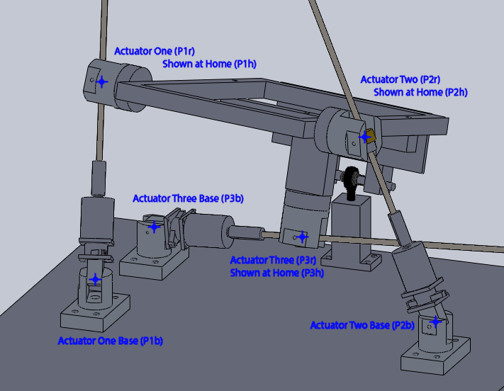
Mechanical Design
Notes:
Replaced Telescope with aluminum frame
System is composed of 3 @ linear actuators
6 @ Dual – Revolute Joints
1 @ Ball Joint

Slide 11
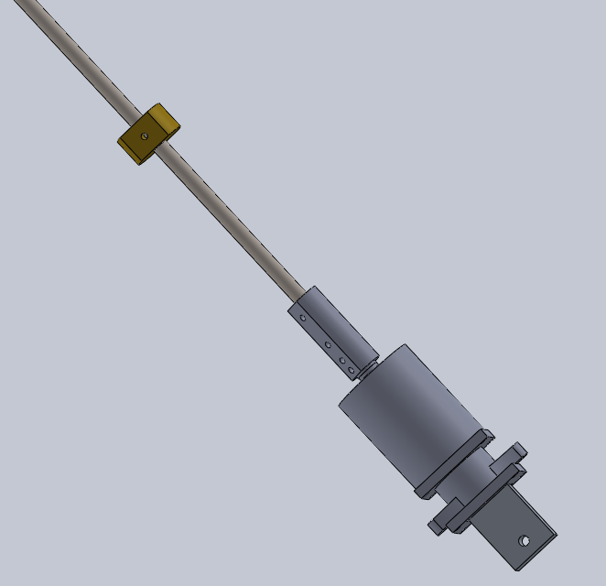
Linear Actuator
Stepper motor
Acme threaded rod
Acme nut
Solid coupler

Slide 12
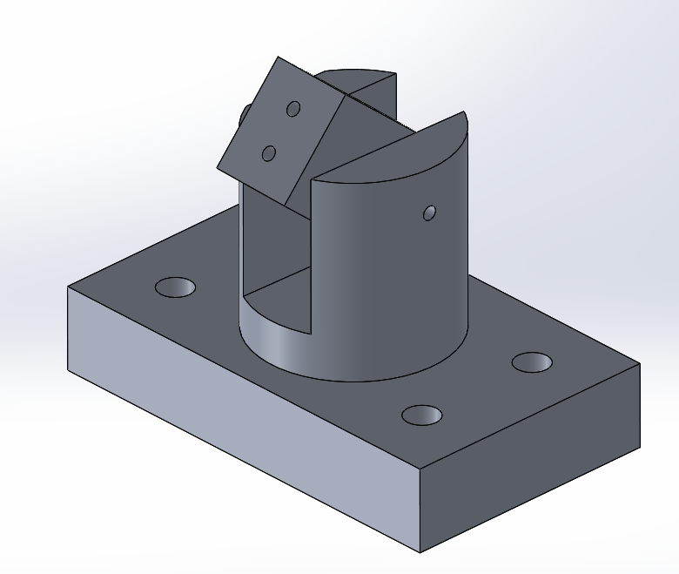
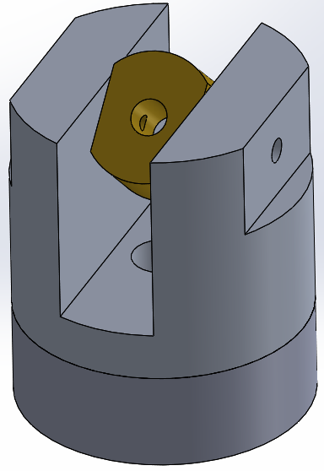
Dual-Revolute Joints
Support either end of linear actuator
Allow linear actuator to act as a two-force member

Slide 13
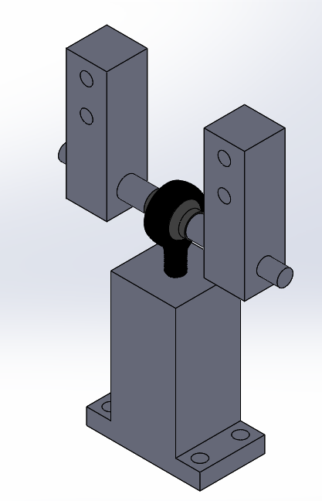
Ball Joint
Prevents translation but allows rotations
rod end ball joint

Slide 14
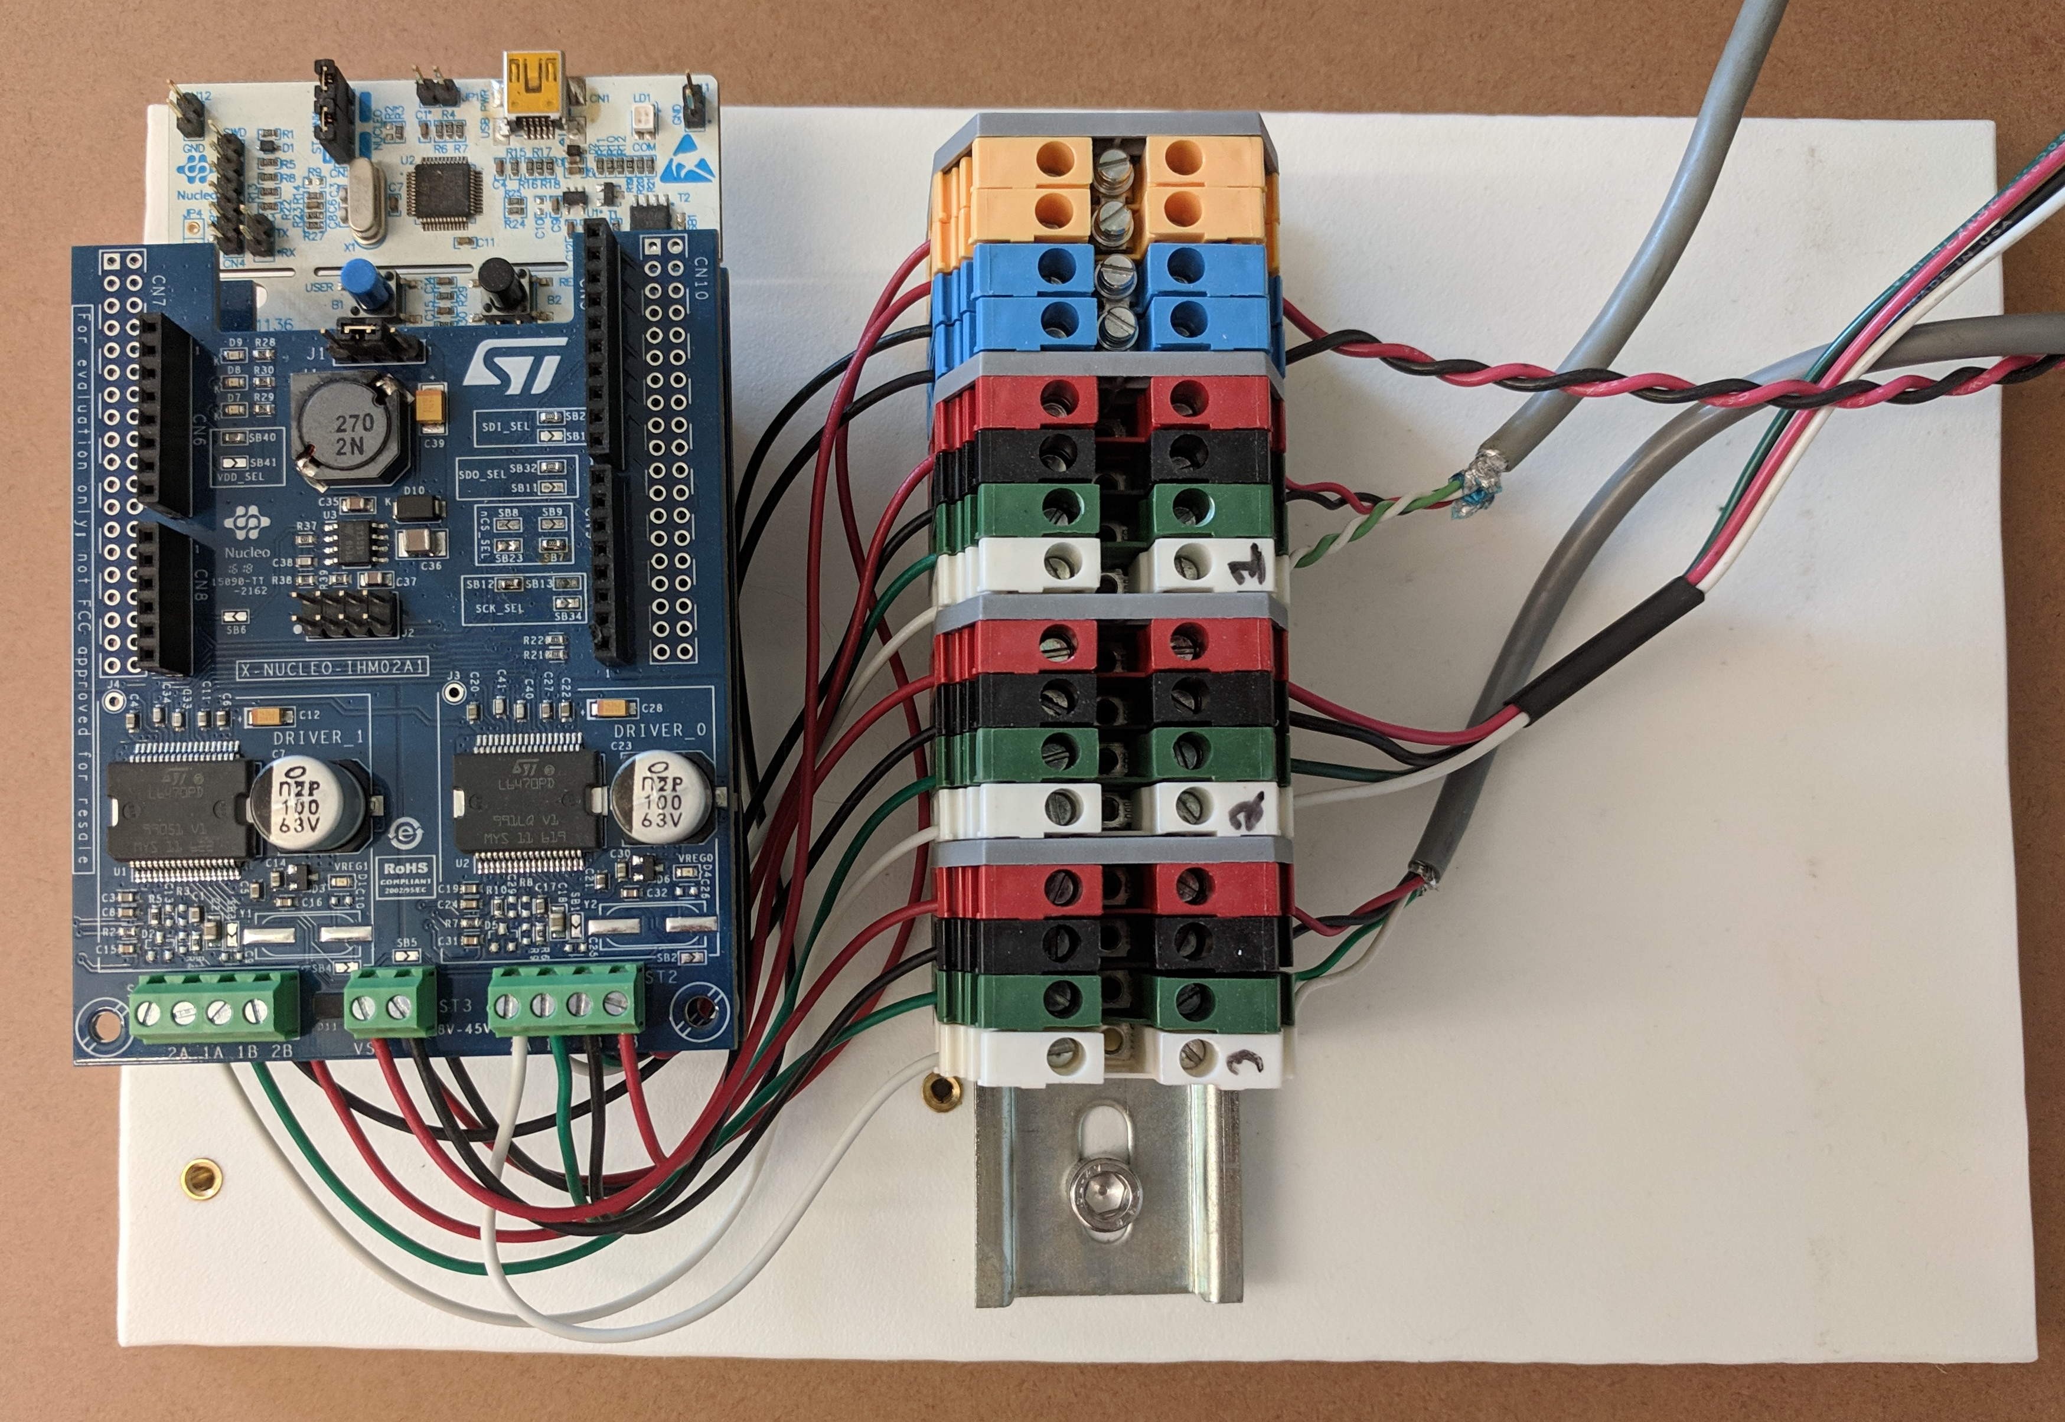
Electrical Design
Notes:
Completely replaced the electrical system
Gudgel had several custom boards
DC motor with encoder and gear box
Comparison of prices
Stepper motor ~ $50 each Nucleo ~ $15
Stepper motor drivers ~30 for both
Dcmotor with encoder: $300 each

Slide 15
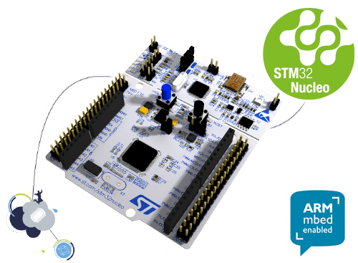
Microcontroller - STM32 Nucleo-L476RG
Onboard Floating Point Unit
80MHz
Micropython compatible
Low cost
Notes:
Used in Dr. Ridgely mechatronics courses

Slide 16

Micropython
Compatibility
OS agnostic
Direct control of hardware
Published under MIT License
https://github.com/micropython/micropython/blob/master/logo/vector-logo-inkscape_master.svg
Notes:
Implementation of Python 3 optimized for use on microcontrollers
Interfaces easily with python on computers
Includes a subset of the Python standard library

Slide 17
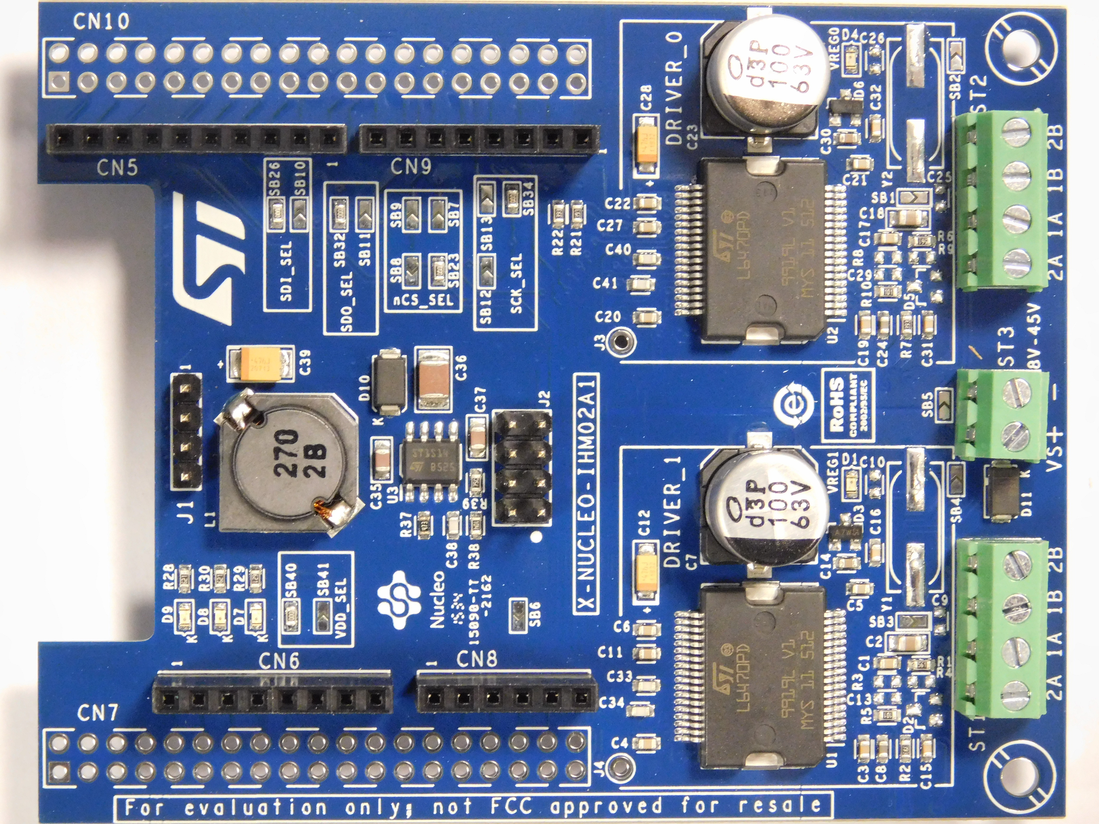
Stepper Motor Driver – L6470
Microstepping
Daisy chainable SPI
Tunable motor parameters
No Micropython driver
Notes:
Move this to slide-> No micropython drivers available. Had to write them.
SPI – Serial Peripheral Interface
Bipolar stepper motor driver with up to 1/128 microstepping

Slide 18
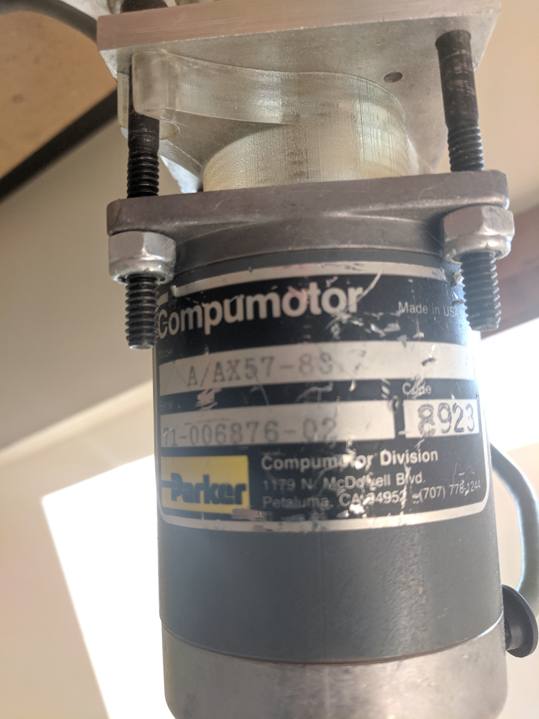
Stepper Motor
Salvaged stepper motors
200 steps/rev
9.4VDC
100 oz-in holding torque
Notes:
Probably needed higher torque
Accuracy seems fine but 400 steps/rev would be nice
Add number for granularity. How small is small?

Slide 19
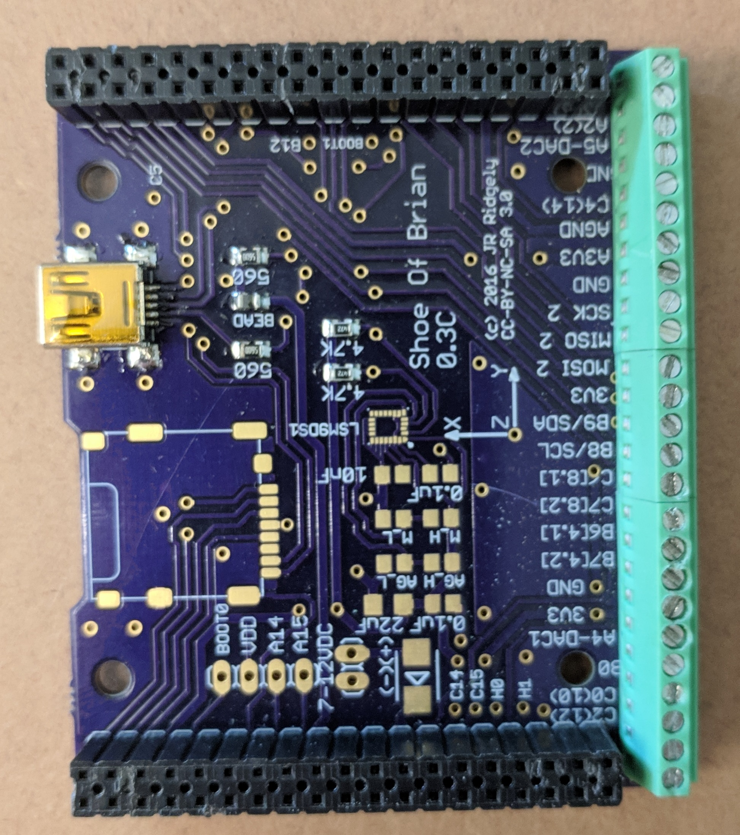
Shoe of Brian
“Cast off the shoes! Follow the gourd!”
Only non-commercial part of the electrical system
Required to install micropython on the Nucleo
Notes:
Why is it called shoe of brian?

Slide 20
Control System

Slide 21
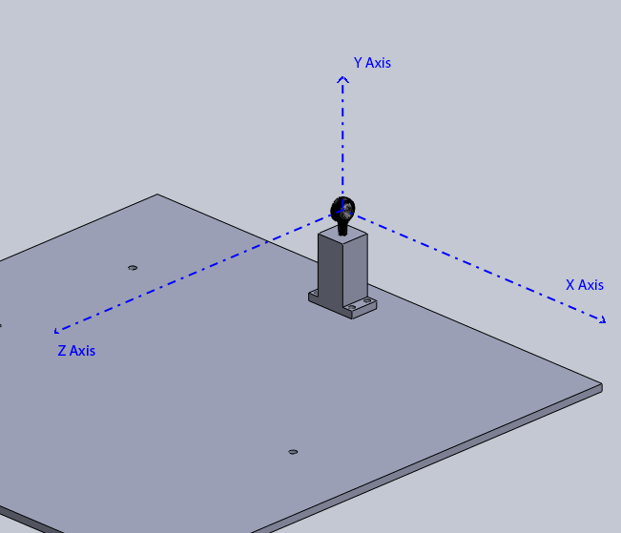
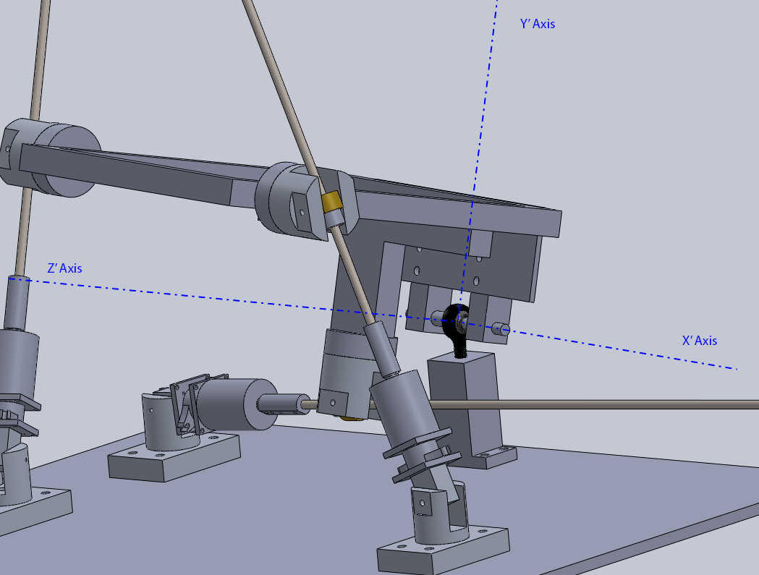
Transformation Coordinate Systems
Base Coordinate System – ‘b’
Telescope Coordinate System – ‘s’
Notes:
Because no direct measurement of angles, must use known home position
Rotation about Y, then X, then Z – explain why this order
Always referencing the home position makes calculating lengths easy

Slide 22
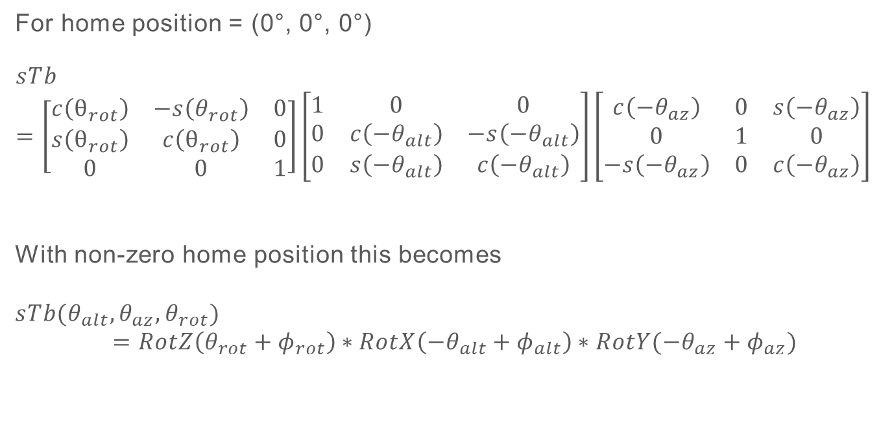
Transformation Matrices
For home position = (0°, 0°, 0°)
$$sTb=\left[\begin{matrix}c\left(θ_{rot}\right) & −s\left(θ_{rot}\right) & 0 \\ s\left(θ_{rot}\right) & c\left(θ_{rot}\right) & 0 \\ 0 & 0 & 1\end{matrix}\right]\left[\begin{matrix}1 & 0 & 0 \\ 0 & c\left(−θ_{alt}\right) & −s\left(−θ_{alt}\right) \\ 0 & s\left(−θ_{alt}\right) & c\left(−θ_{alt}\right)\end{matrix}\right]\left[\begin{matrix}c\left(−θ_{az}\right) & 0 & s\left(−θ_{az}\right) \\ 0 & 1 & 0 \\ −s\left(−θ_{az}\right) & 0 & c\left(−θ_{az}\right)\end{matrix}\right]$$
With non-zero home position this becomes
$$sTb{(θ}_{alt}, θ_{az},θ_{rot})=RotZ\left(θ_{rot}+φ_{rot}\right)∗RotX\left(−θ_{alt}+φ_{alt}\right)∗RotY(−θ_{az}+φ_{az})$$
Notes:
Where $θ_{alt}$, $θ_{az}$, and $θ_{rot}$ are the desired angles for the telescope.
These equations allow us to find the end points of the linear actuators for any altitude, azimuth, and image rotation. Which in turn means the length of the actuators can be calculated for any set of angles.

Slide 23
Angular Velocity
Time derivative of the transformation matrix
Forward calculation of position
Notes:
Velocity trans matrix requires instantaneous angles. Not known
No simple way to go from length to angle
Gudgel implemented Newtonian update method for this
Required linear velocities are calculated by taking a time step, forward calculating the required angular positions after that time step had occurred, finding the lengths required for that new position, and calculating the linear velocities required to move from the current position to the new one. After running for one timestep seconds, the process is repeated.
Choosing timestep is very important
Talk about angular velocity vs constant linear velocity

Slide 24
Testing
Notes:
Three lasers mounted
Add picture!

Slide 25
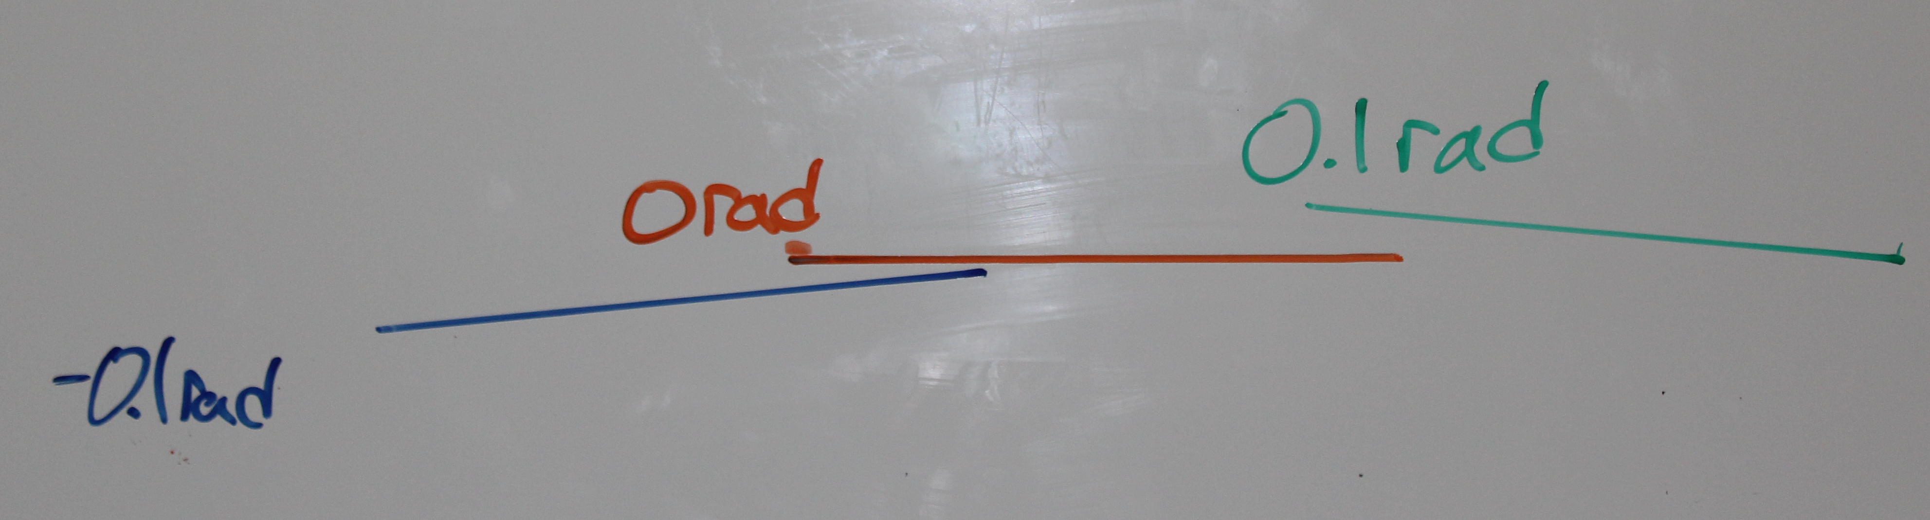
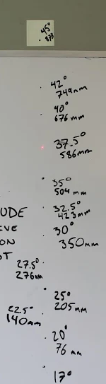
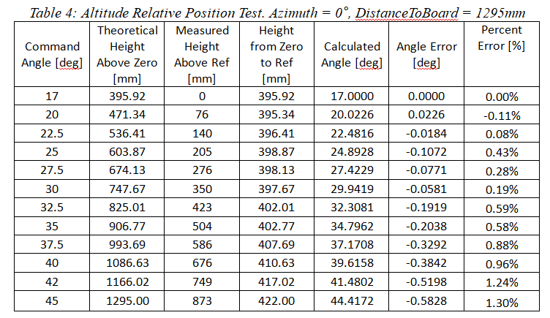
Relative Positioning
Rotation
Altitude
Notes:
Rotation shows non- symmetric error. Image modified to put 0 horizontal. Lines at different level because
Altitude has max error of 1.3% at 45degrees
Increasing error due to error stackup

Slide 26
Velocity
 | Command Velocity [rad/s] | Starting Position [rad] | Ending Position [rad] | Time to Completion [s] | Calculated Velocity [rad/s] | % Error
Altitude 1 | 0.001 | 0.29 | 0.6 | 317.580 | 0.00098 | 2.39
Altitude 2 | 0.002 | 0.29 | 0.6 | 161.162 | 0.00192 | 3.82
Azimuth 1 | 0.004 | -0.2 | 0.2 | 104.852 | 0.00381 | 4.63
Azimuth 2 | 0.006 | -0.2 | 0.2 | 69.564 | 0.00575 | 4.16
Notes:
Command telescope to two positions and mark
Time how long it moves between

Slide 27
Repeatability

Slide 28
Design Recommendations

Slide 29
Geometry

Slide 30
Bearings

Slide 31
Questions?

